Slide 1
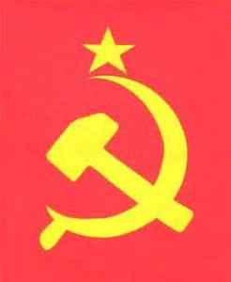
Communism and the Russian Revolution
Southwest Middle School

Slide 2
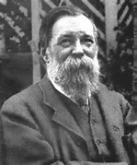
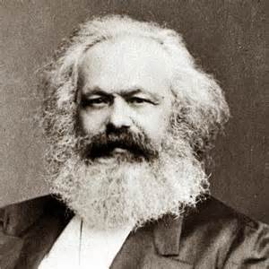
Karl marx and Friederick Engles
Karl Marx and Friederick engles wrote The Condition of the Working Class in England (1845)
Communist Manifesto written in 1848
Claims that all history is “the history of class struggles”
Essentially says that the working class people need to unite and overthrow the powerful and rich.

Slide 3
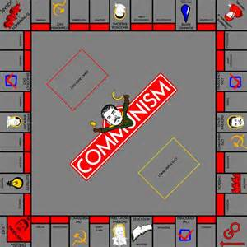
Class warfare
Claims that the working people are in a constant struggle with the owners of the businesses
Proletariat (workers) are always fighting against the bourgeois (business owners)
Marx accuses the bourgeois of using their power to constantly exploit the workers and that they change laws and social conditions to ensure that they always stay in control

Slide 4
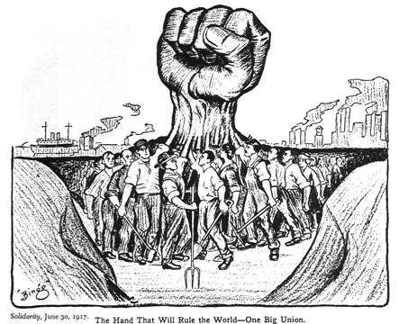
The end of the exploitation
Marx claims that the way to end the class struggle is for the proletariat to establish labor unions and riot
riot= violence
The only way to end the struggle permanently is to have a revolution and to establish a communist government

Slide 5
Capitalism vs. communism
 | Communism | Capitalism
Who owns property? | The government | Individuals
What kind of government is needed? | Totalitarian—dictatorship | Democracy or Republic Sometimes constitutional monarchy
Equal rights? | Yes | Yes
Robin Hood (take from the rich to give to the poor) | Yes—need to “redistribute the wealth.” | No—Everyone gets what they earn
Standard of Living | Seeks to equalize everyone’s standard of living, so nobody lives better than anybody else. | Vast discrepancies based on earning and income potential

Slide 6
Russian Revolution--Roots
Vladimir Lenin establishes the Bolshevik (Marxist) party in 1903 in Russia
Many peasants and workers in Russia were very angry at the way the Tsar used his power to continue to expand his power as well as the power of the wealthy portion of Russian society.
Communist support was very limited in Russia until World war 1 brought several important groups of people together in unison against the Tsar
Military—forced to fight with limited supplies and really bad tactics
Peasants—Starving since food sent from the farms to the troops
Academics—college students disillusioned with current system of government
Workers—Tired of being exploited in factories

Slide 7
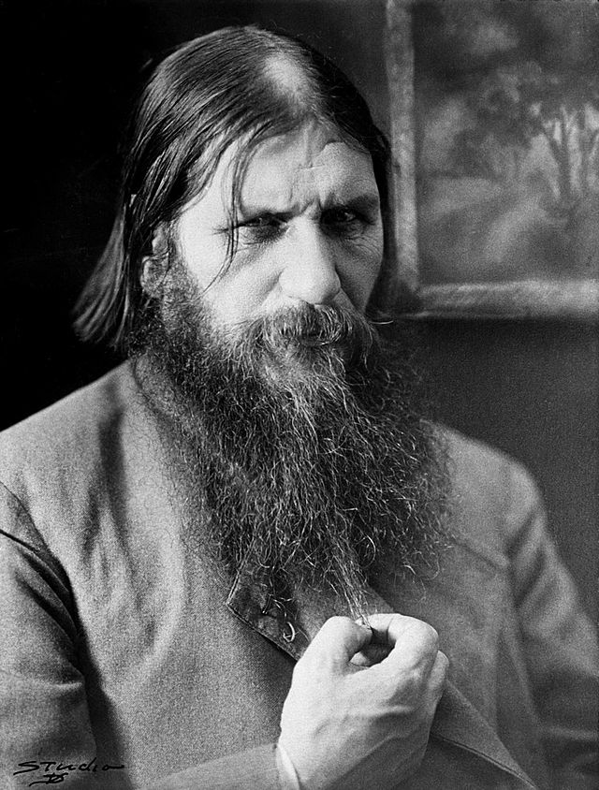
Rasputin
Close advisor to the Tsar
Illiterate
Mystic—believed he had special powers to heal hemophilia of the tsar’s son, Alexander
Advised the tsar to take total control of the military (despite the fact that he had no military experience) which he did in 1915 against every other advisor’s suggestion

Slide 8
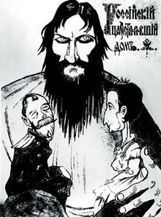
Discrediting the monarchy
Popular belief in Russian government officials was that Rasputin was actually running the country
Extraordinary losses of Russian soldiers led many to revolt against the tsar
October 1917—The October revolution
Seizure of the government in 1917 and imprisonment of the tsar

Slide 9
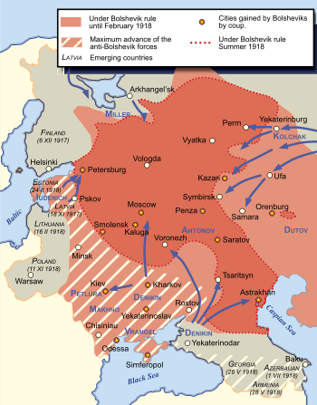
Russian Revolution (Civil War)
From 1917-1922, Russian groups fought with one another to control the country
Primary battle was between the Reds (Bolshevik Marxists) and Whites (assorted groups united against the communists)
Red Army was composed largely of former military officers (75% of all officers were former Russian Tsarist Officers)
Most of the soldiers were peasants
White army—middle class, land-owners, monarchists, army generals, and many others
Controlled a lot of Russia throughout the war

Slide 10
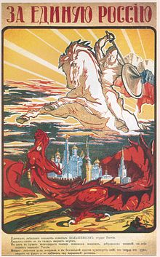
Red victory
At least an additional 1.5 million Russians were killed in fighting during the Russian revolution
Official records are incomplete
Whites were eventually unable to separate themselves from tsar Nicholas and therefore never gained the popularity needed to beat the reds.
By 1921, fighting was erratic and the Bolsheviks (led by Vladimir lenin ) had defeated the whites

Slide 11
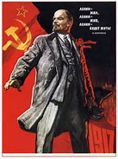
Aftermath of the Russian Revolution
Formation of the Soviet Union—Fighting in Ukraine, Estonia, Latvia, and parts of finland, Poland, and central asia (Balkans) had caused many independent regions to be united with the reds and russia
Vladimir Lenin—Becomes the leader of the soviet union
Implements communism in the soviet union (called Leninism)
1st communist government in the world
Leon Trotsky—leader and hero of the red army

